Slide 1
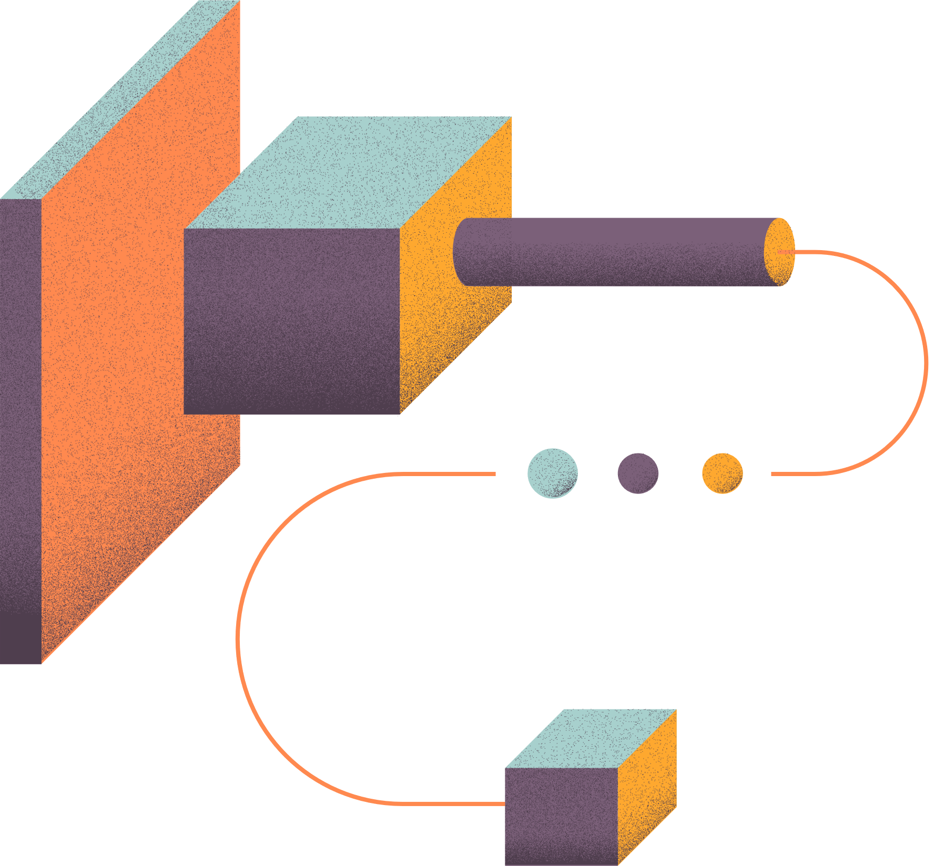
MACHINE LEARNING KAGGLE COMPETITION RESULTS
Dibyarup Pal and B Rahul

Slide 2

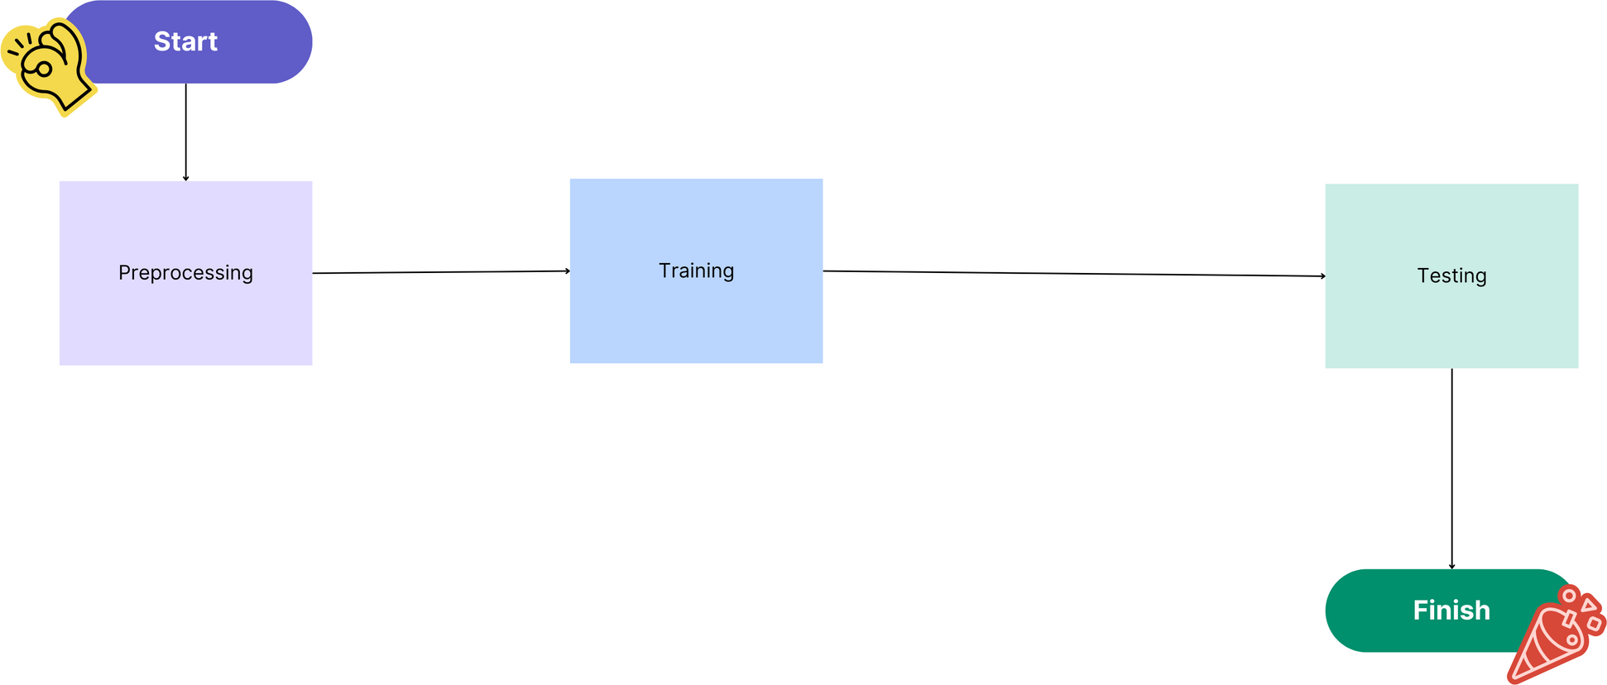
GENERAL FLOW

Slide 3
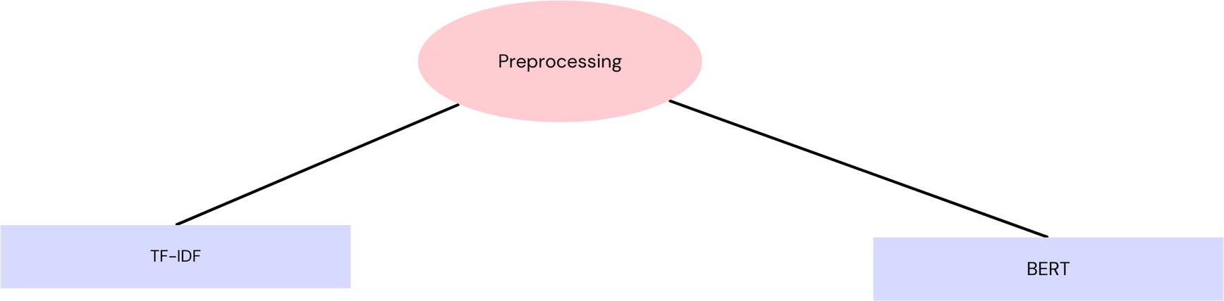
PREPROCESSING

Slide 4
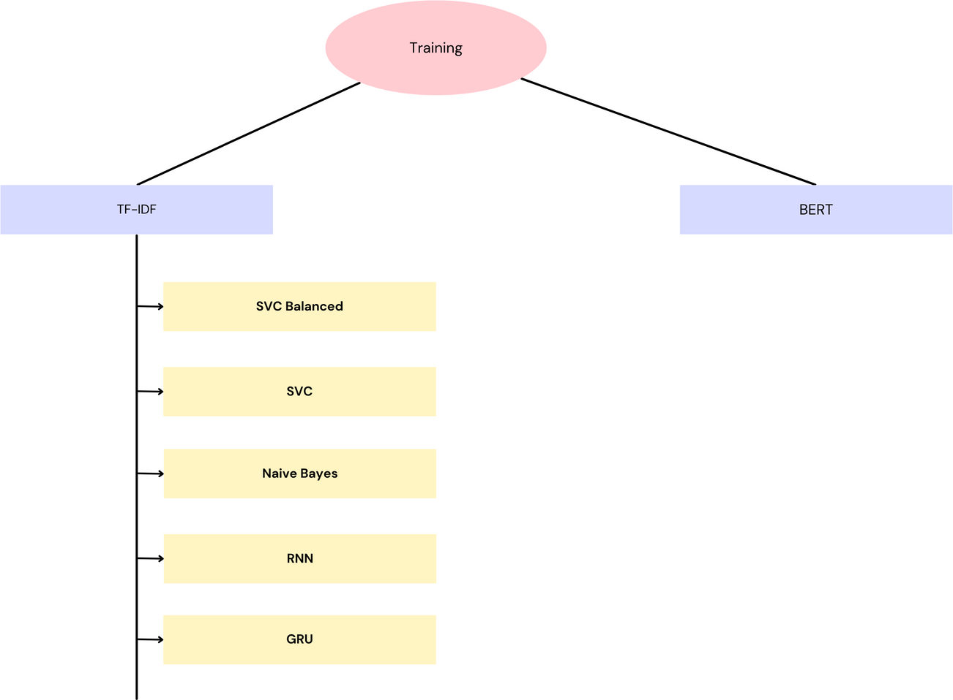
TRAINING

Slide 5
Training Model with Single Columns ( Text Only )
Model | Accuracy
SVC Balanced | 0.46473
SVC | 0.47586
Naive Bayes | 0.32865
RNN | 0.54727
GRU | 0.54441
BERT (200000 Data) | 0.58049
BERT (400000 Data) | 0.59124 (Our Best Score)

Slide 6
Training Model with Multiple Columns
Model | Accuracy
RNN | 0.54034
RNN (Changing Hyperparameters) | 0.5366
GRU | 0.53964

Slide 7
T h a n k Y o u

